Slide 1
Food Glorious Food
But even better when it does good too

Slide 2
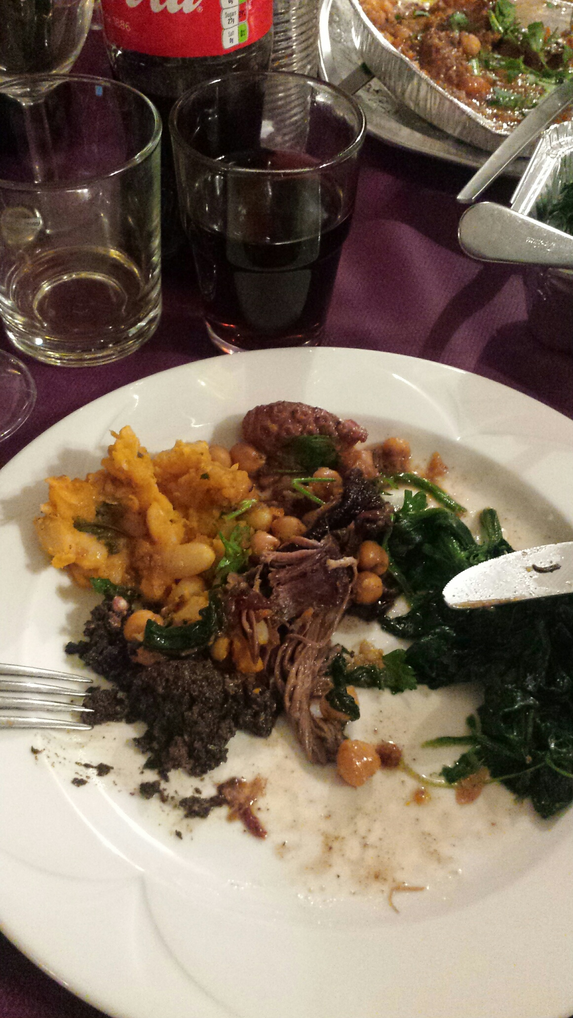
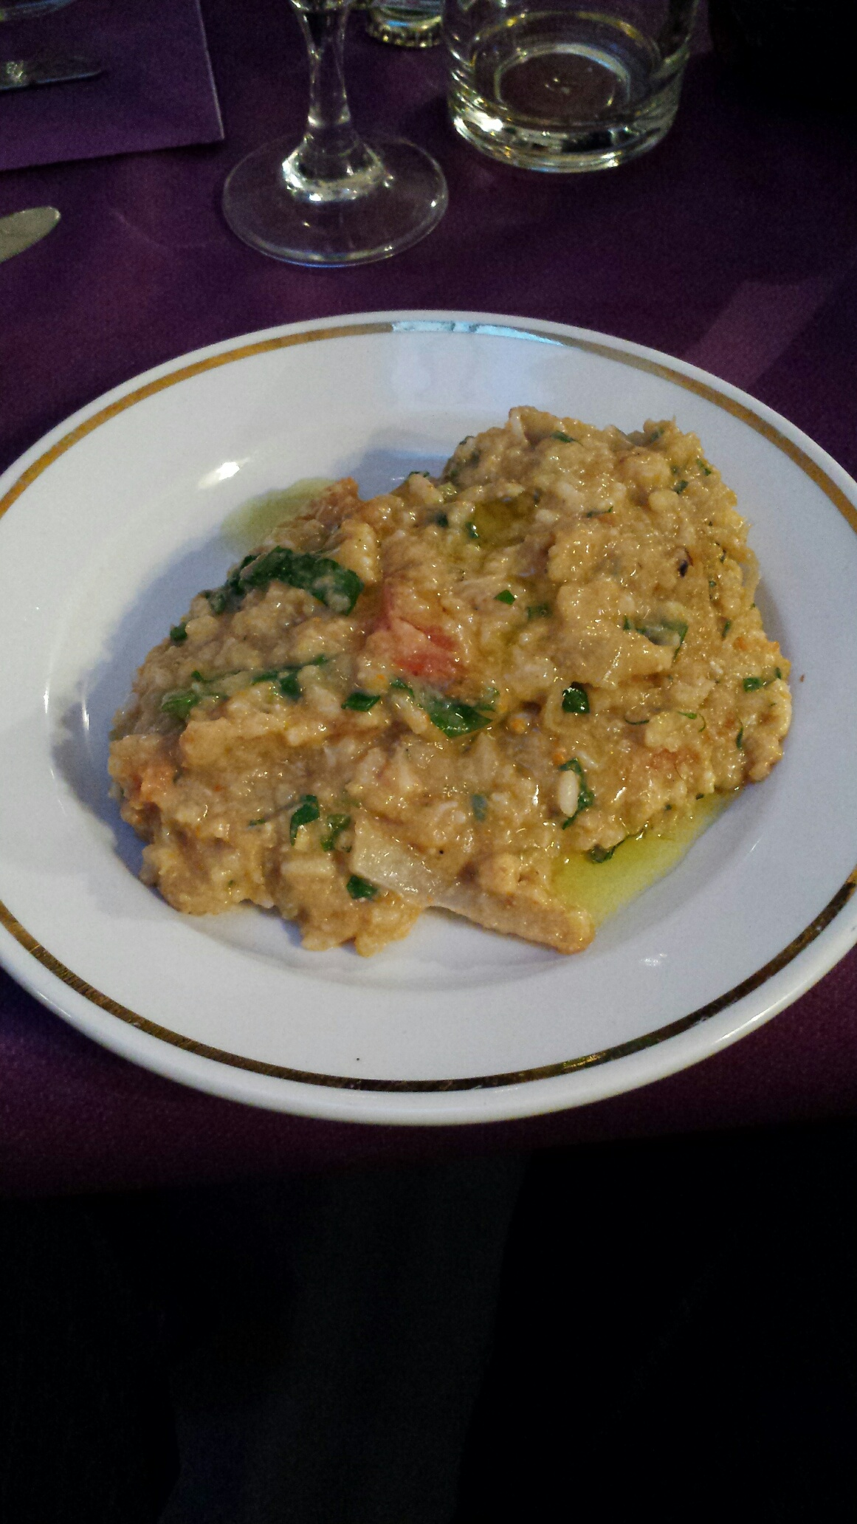
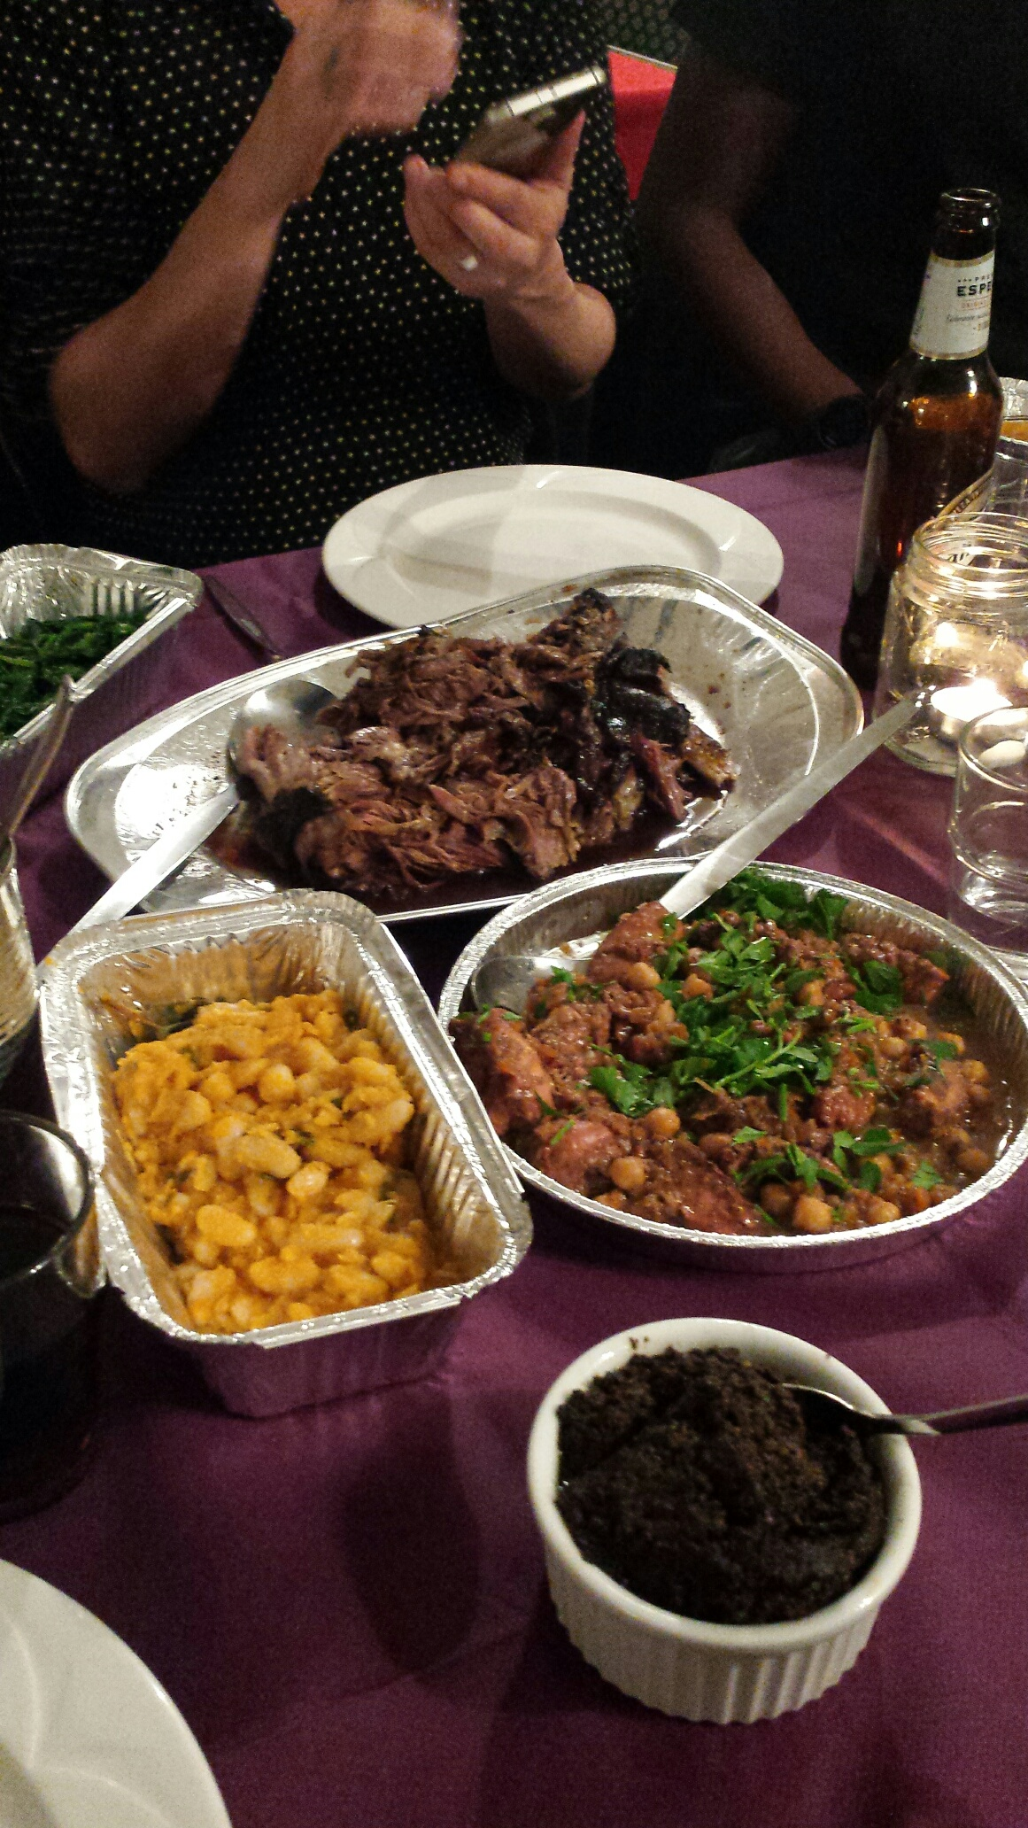

Slide 3
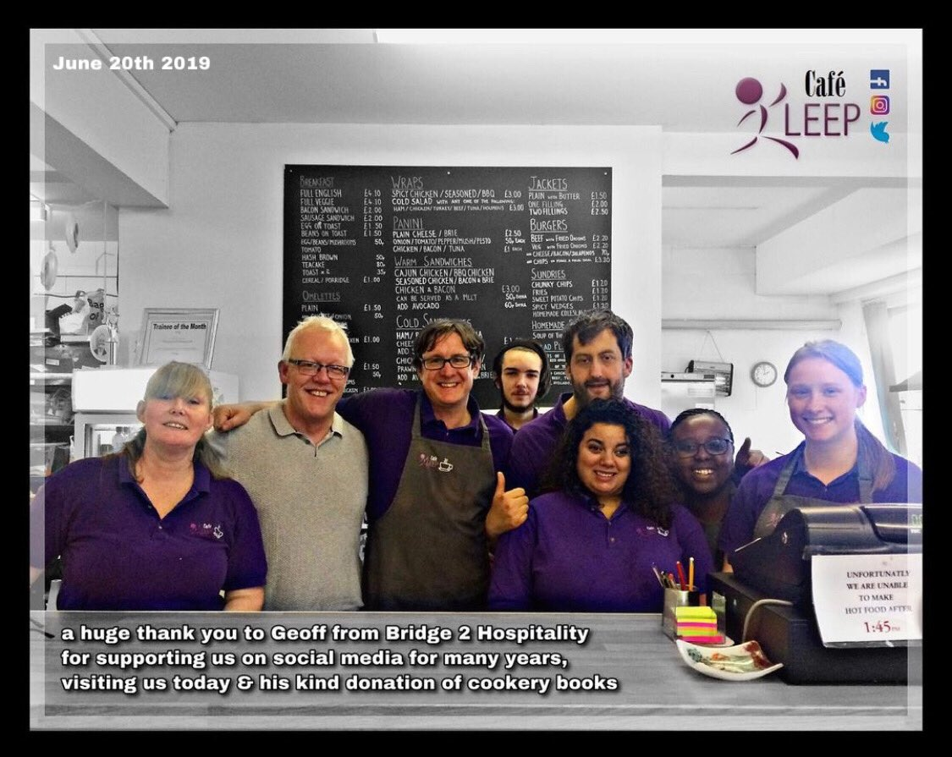
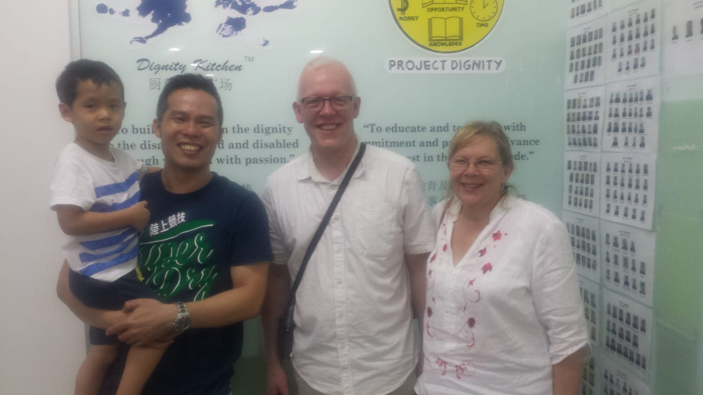
Some places I’ve been…
Leeds – Café Leep
Singapore – Dignity Kitchen
London – Clink, High Down
Brigade Bar & Kitchen

Slide 4
Sources of good food places to eat…
Bridge To Hospitality
Appy Maps
Sustain UK Good Food Map

Slide 5
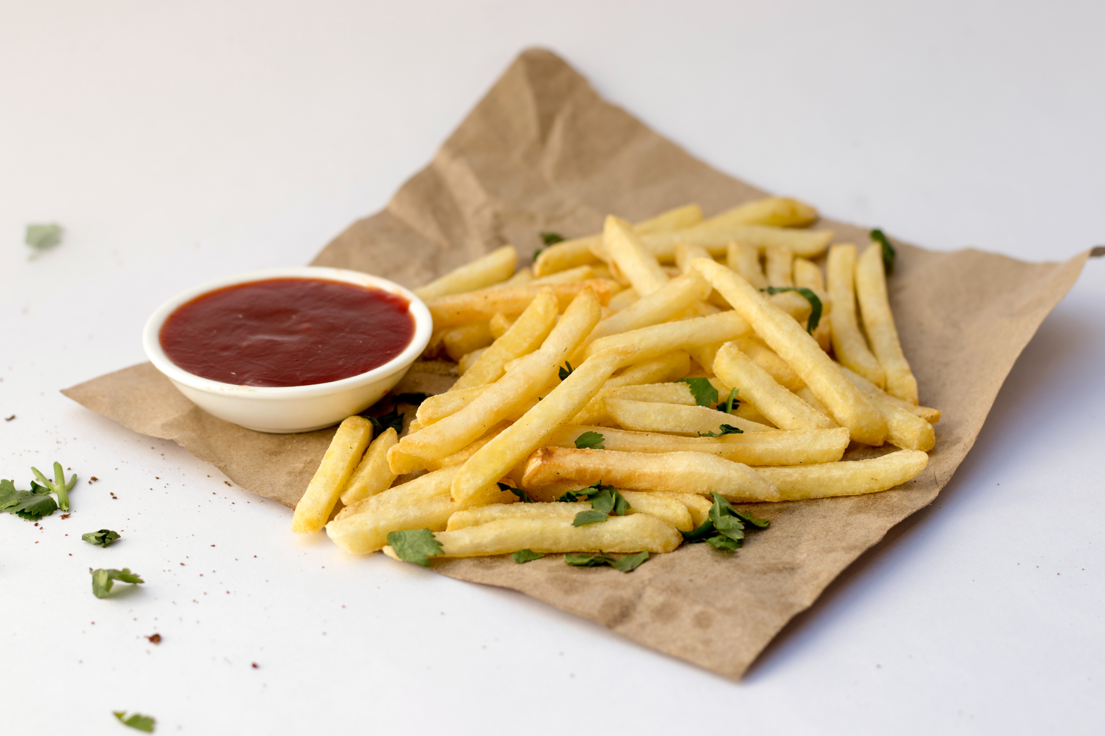
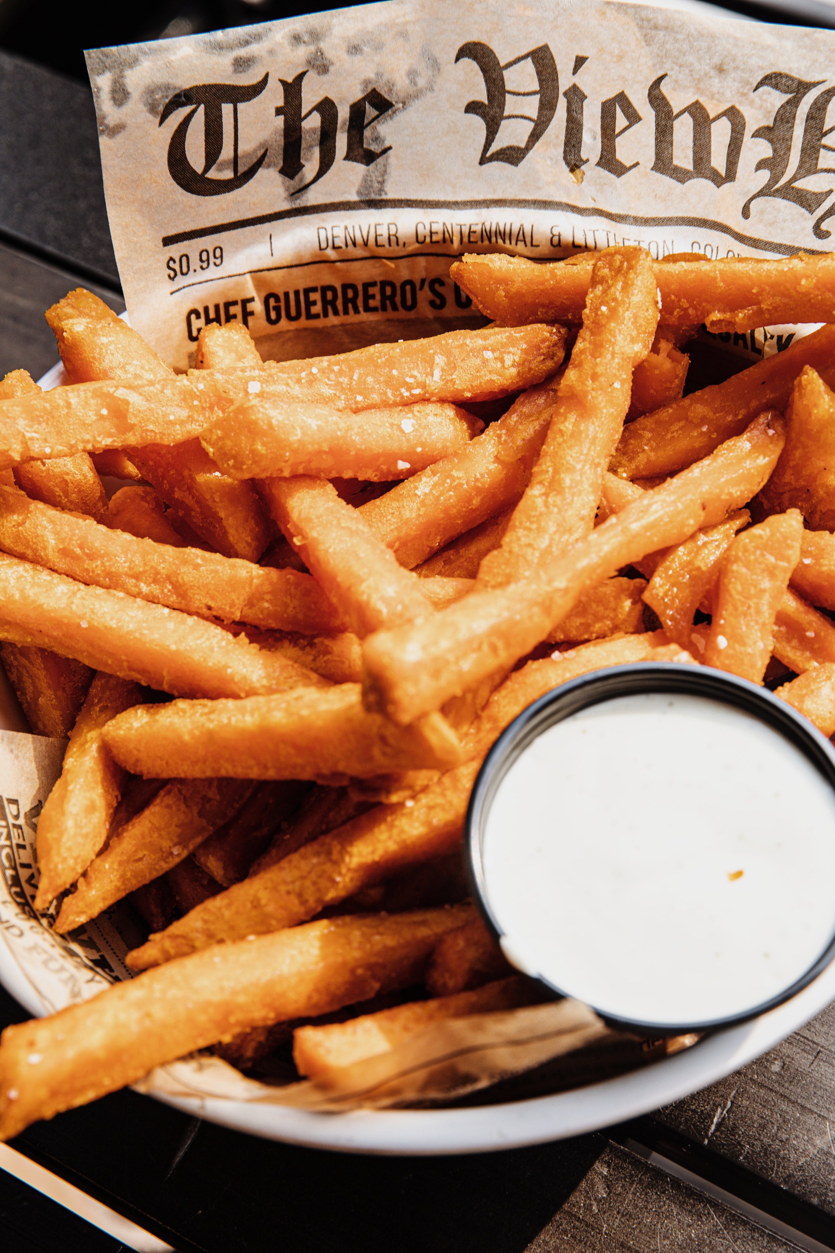
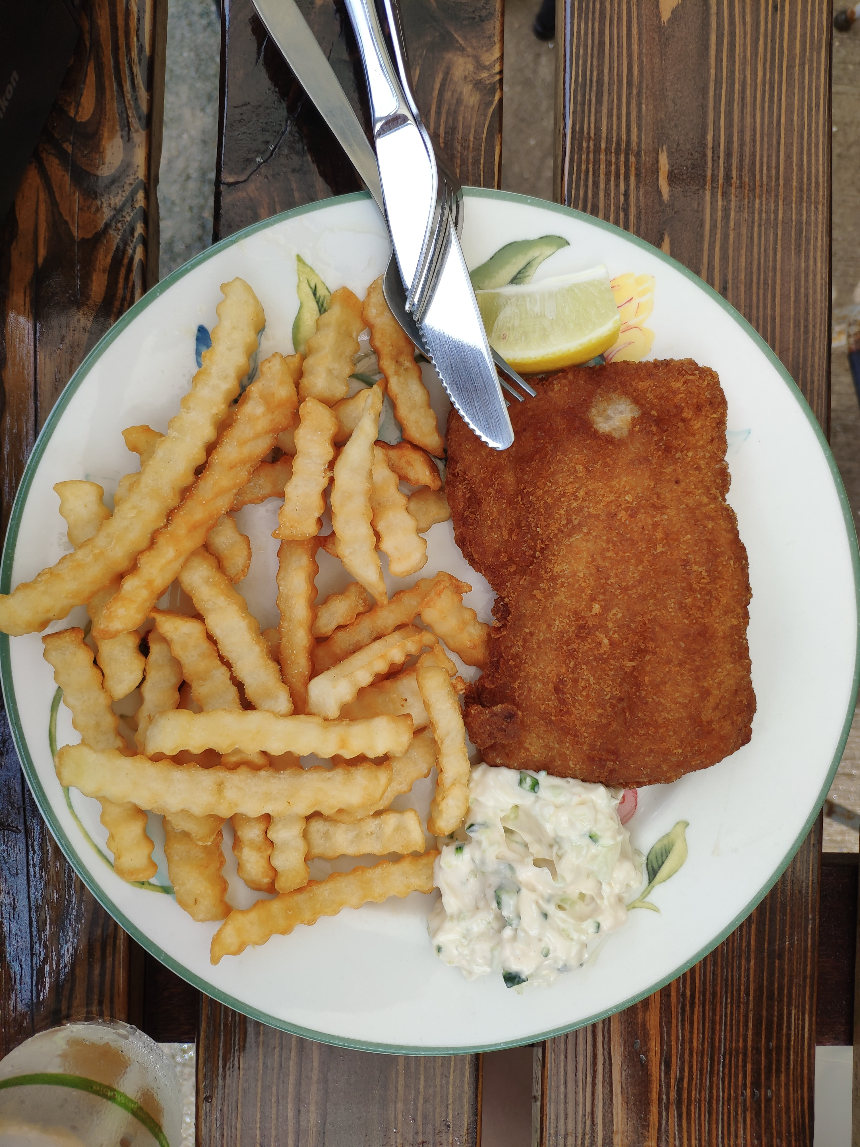

Slide 6
How hospitality action help…
Hardship Grants
Employee Assistance Programmes
Support for drug and alcohol abuse, mental health
How you can help
Look for the Invisible Chips sign and order a portion
If you don’t see one, ask your local restaurant to supply them
Buy them online

Slide 7
Thank you
someone@example.com

